Slide 1
Nearsightedness
A guide to seeing
www.citroenogen.nl

Slide 2
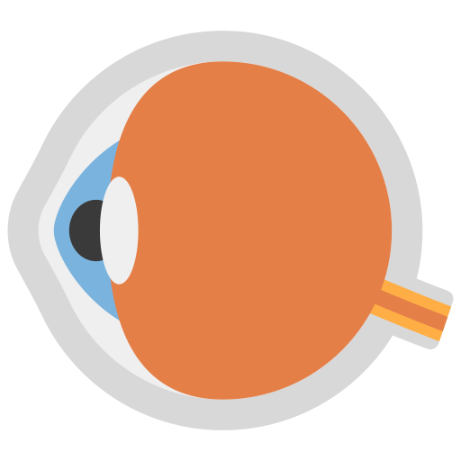
What is nearsightedness?
Nearsightedness or myopia is an increasingly common eye problem, where you can see things clearly when they are close by, but things that are further away look blurry.
www.citroenogen.nl

Slide 3
What is nearsightedness?
This happens when your eye ball is longer than it should be. So your eye will look more like a lemon than a ball. Light should shine right onto the back of your eye (retina), but for people with this condition it shines in front of the retina, which causes a blur in their vision.
www.citroenogen.nl

Slide 4
How is nearsightedness noted?
0D
The power of a lens is measured in Diopters (D), but most people only talk about plus (+) and minus (-). People with nearsightedness have a number that has a minus.
The higher the number, the blurrier their vision.
-3D
-6D
www.citroenogen.nl

Slide 5
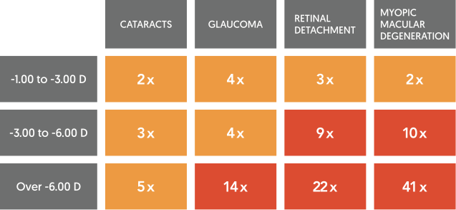
Why is nearsightedness bad?
With bad management nearsightedness can lead to different eye diseases like, cataracts, glaucoma, myopic macular degeneration and retinal detachment. The management might not stop the backward progression of your eyes until you are older, but it will help in keeping the nearsightedness minimal.
Amount of times more likely to get eye disease with myopia
www.citroenogen.nl

Slide 6
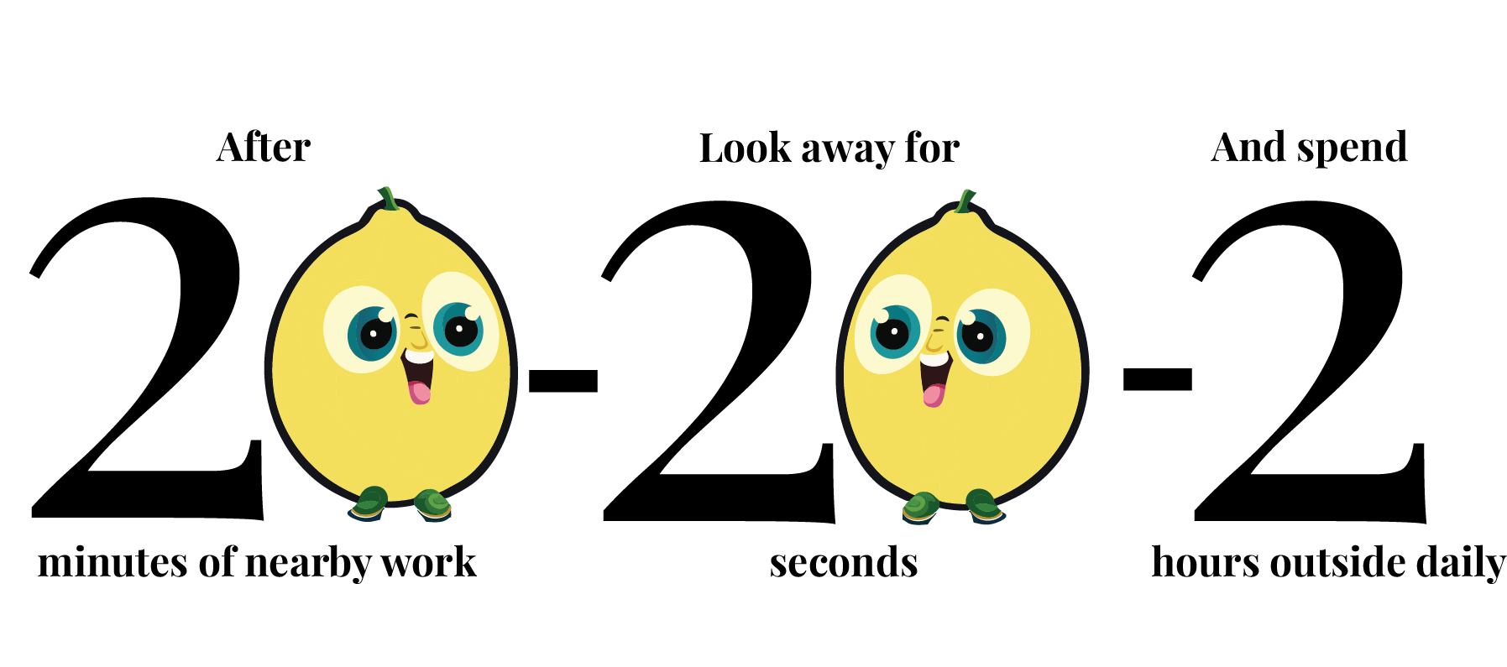
How to stop nearsightedness?
When implementing the 20-20-2 rule, you can stop or decrease the height of the Diopter (-).
www.citroenogen.nl

Slide 7
How to stop nearsightedness?
The first 20 means that the rule starts after you have been working for twenty minutes on something where you are looking at an object close to your eyes, so for example your phone, book or drawing.
www.citroenogen.nl

Slide 8
How to stop nearsightedness?
The second twenty talks about the thing you have to do after the 20 minutes. This is to look away into the distance for at least 20 seconds. So, maybe look at the farthest tree you can see out of your window.
www.citroenogen.nl

Slide 9
How to stop nearsightedness?
The two at the end is separate from the other numbers. This one is something you should do every day. Spend at least two hours outside. Sunlight proves to be good at stopping nearsightedness from progressing. And being outside is also good for other parts of your health
www.citroenogen.nl

Slide 10
How to stop nearsightedness?
You might ask, ‘Don’t glasses work?’
To be honest, glasses don’t help slowing down nearsightedness.
Sunlight and limited screen time show an ability to slow down this progression.
www.citroenogen.nl

Slide 11
How to slow nearsightedness?
If you already are nearsighted, it is still important to use ways to stop it from getting worse. Glasses will help to make your vision less blurry again. This will not stop your eyes from growing more nearsighted. Special glasses, lenses or eye drops might stop this.
www.citroenogen.nl

Slide 12
I think I am nearsighted
If you feel like you have this condition, don’t be worried to talk about it with your parents or teacher. Nearsightedness is very common, and if you find it early in your life you can be helped. This will make it possible to keep the nearsightedness at a minimum.
www.citroenogen.nl

Slide 13
If you want to know more, or tell
your parents about it
Check www.citroenogen.nl
www.citroenogen.nl

Slide 14
References & Attributions
This presentation has been designed using images from Flaticon.com, made by Freepik, Juicy_fish, smashingstocks
Slide 4: Photo in blur by Ben Wicks on Unsplash (blurred with https://pinetools.com/blur-image: no blur, stack blur 60, stack blur 100)
Slide 5: Table by www.kidsorthok.com.au/myopia-control
More information:
https://www.allaboutvision.com/parents/myopia-facts-infographic.htm
https://mymyopia.com/the-new-myopia-infographic-that-your-patients-need-to-see/
https://www.reviewofoptometry.com/article/pediatric-eye-care-not-a-priority-to-parents
www.citroenogen.nl

